Slide 1

Artificial Intelligence and Machine Learning Unit:- 04
Presented By:
Mrs. Akanksha Mishra
Assistant Professor
Department of IT

Slide 2

Introduction
Machine learning (ML) is a Subclass of artificial intelligence (AI) that allows software applications to become more accurate at predicting outcomes without being explicitly programmed to do so.
Machine learning is a growing technology which enables computers to learn automatically from past data. Machine learning uses various algorithms for building mathematical models and making predictions using historical data or information. Currently, it is being used for various tasks such as image recognition, speech recognition, email filtering, Facebook auto-tagging, recommender system, and many more.

Slide 3
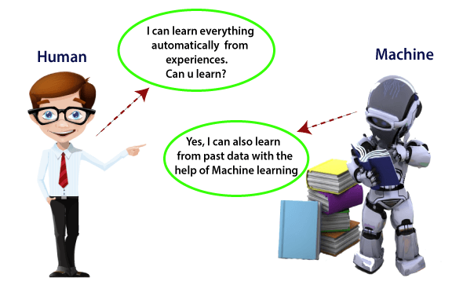

Slide 4
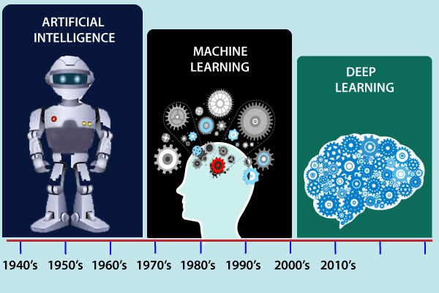
History Of Machine Learning

Slide 5
Features of Machine Learning:
Machine learning uses data to detect various patterns in a given dataset.
It can learn from past data and improve automatically.
It is a data-driven technology.
Machine learning is much similar to data mining as it also deals with the huge amount of the data.

Slide 6
Prerequisites Before learning machine learning, you must have the basic knowledge of followings so that you can easily understand the concepts of machine learning:
Fundamental knowledge of probability and linear algebra.
The ability to code in any computer language, especially in Python language.
Knowledge of Calculus, especially derivatives of single variable and multivariate functions.

Slide 7
Application Of Machine Learning
Rapid increment in the production of data
Solving complex problems, which are difficult for a human
Decision making in various sector including finance
Finding hidden patterns and extracting useful information from data.

Slide 8
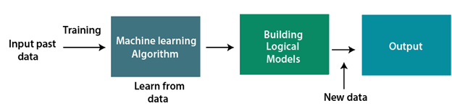
How does Machine Learning work
A Machine Learning system learns from historical data, builds the prediction models, and whenever it receives new data, predicts the output for it. The accuracy of predicted output depends upon the amount of data, as the huge amount of data helps to build a better model which predicts the output more accurately.

Slide 9
Need for Machine Learning
The need for machine learning is increasing day by day. The reason behind the need for machine learning is that it is capable of doing tasks that are too complex for a person to implement directly. As a human, we have some limitations as we cannot access the huge amount of data manually, so for this, we need some computer systems and here comes the machine learning to make things easy for us.
We can train machine learning algorithms by providing them the huge amount of data and let them explore the data, construct the models, and predict the required output automatically. The performance of the machine learning algorithm depends on the amount of data, and it can be determined by the cost function. With the help of machine learning, we can save both time and money.
The importance of machine learning can be easily understood by its uses cases, Currently, machine learning is used in self-driving cars, cyber fraud detection, face recognition, and friend suggestion by Facebook, etc.

Slide 10
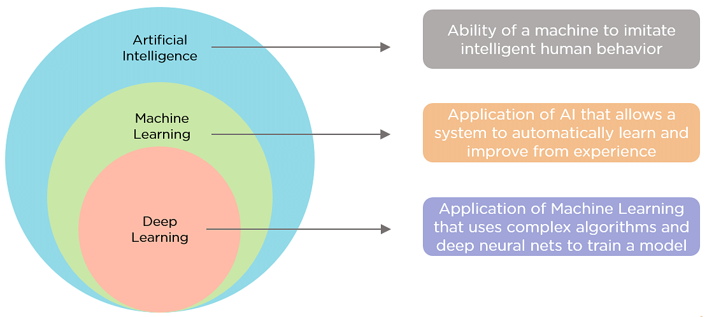
Difference between Machine Learning, Artificial Intelligence and Deep Learning

Slide 11
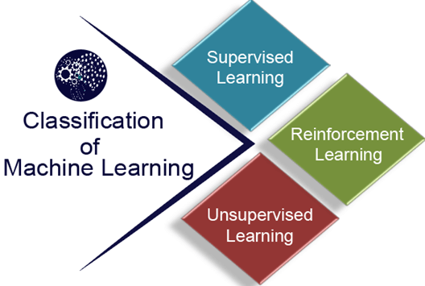
Classification of Machine Learning
Supervised learning
Unsupervised learning
Reinforcement learning

Slide 12
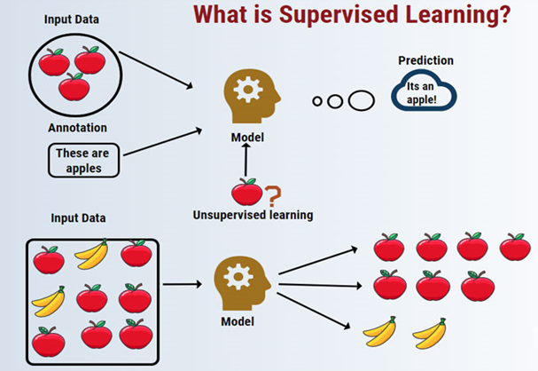
Supervised learning:
In this type of machine learning, data Scientist supply algorithms with labelled training data and define the variables they want the algorithm to assess for correlations. Both the input and the output of the algorithm is specified.

Slide 13
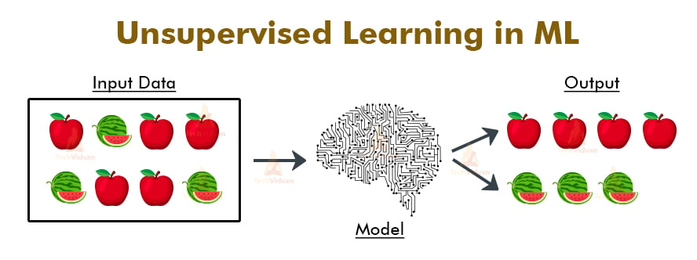
Unsupervised learning:
This type of machine learning involves algorithms that train on unlabelled data. The algorithm scans through data sets looking for any meaningful connection. The data that algorithms train on as well as the predictions or recommendations they output are predetermined.

Slide 14
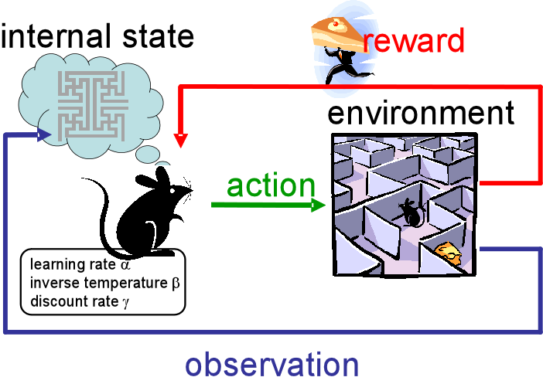
Reinforcement learning:
Data scientists typically use Reinforcement learning to teach a machine to complete a multi-step process for which there are clearly defined rules. Data scientists program an algorithm to complete a task and give it positive or negative cues as it works out how to complete a task. But for the most part, the algorithm decides on its own what steps to take along the way.

Slide 15
Common issues in Machine Learning
Inadequate Training Data. ...
Poor quality of data. ...
Non-representative training data. ...
Overfitting and Underfitting. ...
Monitoring and maintenance. ...
Getting bad recommendations. ...
Lack of skilled resources. ...
Customer Segmentation.

Slide 16
Probably Approximately Correct (PAC) learning
Probably Approximately Correct (PAC) learning is a theoretical framework introduced by Leslie Valiant in 1984. It addresses the problem of learning a function from a set of samples in a way that is both probably correct and approximately correct. In simpler terms, PAC learning formalizes the conditions under which a learning algorithm can be expected to perform well on new, unseen data after being trained on a finite set of examples.
PAC learning is concerned with the feasibility of learning in a probabilistic sense. It asks whether there exists an algorithm that, given enough examples, will find a hypothesis that is approximately correct with high probability. The "probably" aspect refers to the confidence level of the algorithm, while the "approximately correct" aspect refers to the accuracy of the hypothesis.

Slide 17
Core Concepts of PAC Learning
Sample Complexity
Sample complexity refers to the number of samples required for a learning algorithm to achieve a specified level of accuracy and confidence. In PAC learning, sample complexity is a key measure of the efficiency of a learning algorithm. It helps determine how much data is needed to ensure that the learned hypothesis will generalize well to unseen instances.
Hypothesis Space
The hypothesis space is the set of all possible hypotheses (or models) that a learning algorithm can choose from. In PAC learning, the size and structure of the hypothesis space play a crucial role in determining the sample complexity and the generalization ability of the algorithm.
A larger and more complex hypothesis space offers more flexibility and can potentially lead to more accurate models. However, it also increases the risk of overfitting,
Generalization
Generalization is the ability of a learning algorithm to perform well on unseen data. In the PAC framework, generalization is quantified by the probability that the chosen hypothesis will have an error rate within an acceptable range on new samples.
Generalization is a fundamental goal of machine learning, as it determines the practical usefulness of the learned hypothesis

Slide 18
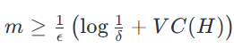
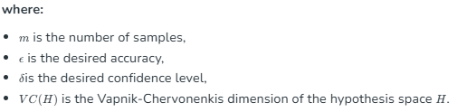
PAC Learning Theorem
The PAC learning theorem provides formal guarantees about the performance of learning algorithms. It states that for a given accuracy (ε) and confidence (δ), there exists a sample size (m) such that any learning algorithm that returns a hypothesis consistent with the training samples will, with probability at least 1-δ, have an error rate less than ε on unseen data.
Mathematically, the PAC learning theorem can be expressed as:

Slide 19
Challenges of PAC Learning
Real-world Applicability
Computational Complexity
Model Assumptions

Slide 20
Bayesian Decision Theory
Bayesian Decision Theory is a simple but fundamental approach to a variety of problems like pattern classification. The entire purpose of the Bayes Decision Theory is to help us select decisions that will cost us the least ‘risk’. There is always some sort of risk attached to any decision we choose. We will be going through the risk involved in this classification later in this article.

Slide 21

Bayesian Decision Theory
Bayesian decision theory is a fundamental statistical approach to the problem of pattern classification. It leverages probability to make classifications, and measures the risk (i.e., cost) of assigning an input to a given class. It is considered the ideal case in which the probability structure underlying the categories is known perfectly. While this sort of situation rarely occurs in practice, it permits us to determine the optimal (Bayes) classifier against which we can compare all other classifiers. Moreover, in some problems it enables us to predict the error we will get when we generalize to novel patterns.
This approach is based on quantifying the tradeoffs between various classification decisions using probability and the costs that accompany such decisions. It assumes that the decision problem is posed in probabilistic terms, and that all the relevant probability values are known.

Slide 22
Bayesian Decision Theory
Let us take an example where an electronics store company wants to know whether a customer is going to buy a computer or not. So, we have the following two buying classes:
w1 – Yes (Customer will buy a computer)
w2 – No (Customer will not buy a computer)
Now, we will investigate the past records of our customer database. We will note down the number of customers buying computers and also the number of customers not buying a computer. Now, we will calculate the probabilities of customers buying a computer. Let it be P(w1). Similarly, the probability of customers not buying a customer is P(w2).

Slide 23

Bayesian Decision Theory
Now we will do a basic comparison for our future customers.
For a new customer,
If P(w1) > P(w2), then the customer will buy a computer (w1)
And, if P(w2) > P(w1), then the customer will not buy a computer (w2)
Here, we have solved our decision problem.
But what is the problem with this basic Decision method? Well, most of you might have guessed right. Based on just previous records, it will always give the same decision for all future customers. This is illogical.

Slide 24
Bayesian Decision Theory
We need something that will help us in making better decisions for future customers. Let’s say we add a feature ‘x’ where ‘x’ denotes the age of the customer. Now with this added feature, we will be able to make better decisions.

Slide 25
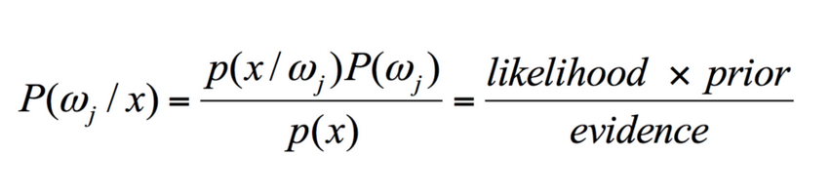
Bayes Theorem and Decision Theory
For our class w1 and feature ‘x’, we have:
There are 4 terms in this formula that we need to understand:
Prior – P(w1) is the Prior Probability that w1 is true before the data is observed
Posterior – P(w1 | x) is the Posterior Probability that w1 is true after the data is observed.
Evidence – P(x) is the Total Probability of the Data
Likelihood – P(x | w1) is the information about w1 provided by ‘x’
P(w1 | x) is read as Probability of w1 given x
More Precisely, it is the probability that a customer will buy a computer, given a specific customer’s age.

Slide 26

Bayes Theorem and Decision Theory
For a new customer,
If P(w1 | x) > P(w2 | x), then the customer will buy a computer (w1)
And, if P(w2 | x) > P(w1 | x), then the customer will not buy a computer (w2)
This decision seems more logical and trustworthy since we have some features here to work upon and our decision is based on the features of our new customers and past records and not just past records as in earlier cases.

Slide 27
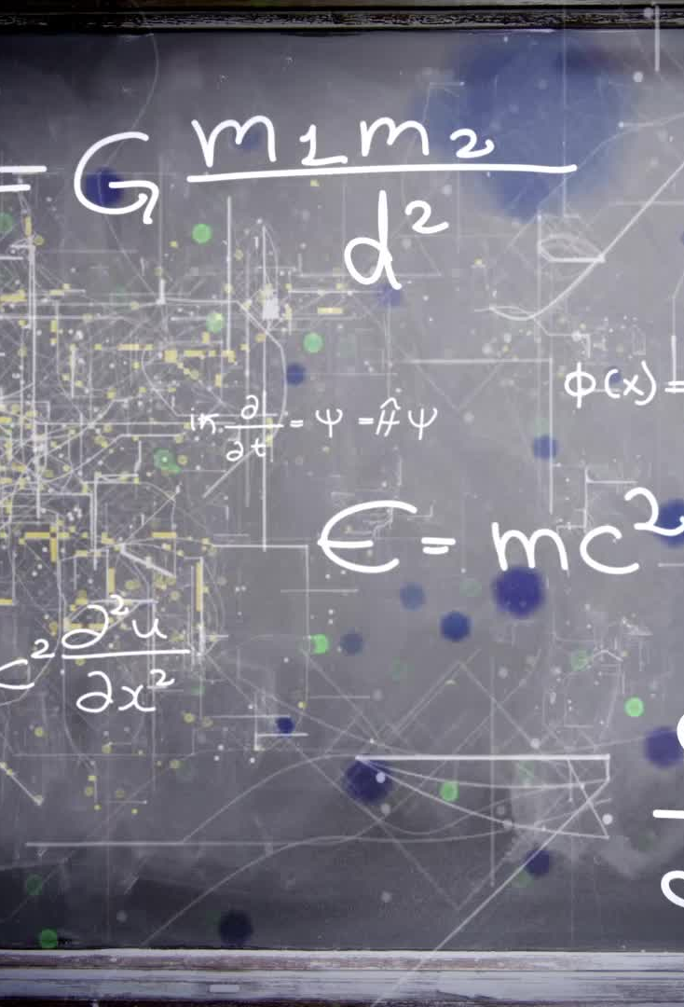
Bayes Theorem and Decision Theory
Now, from the formula, you can see that for both our classes w1 and w2, our denominator P(x) is constant. So, we can utilize this idea and can form another form of decision as below:
If P(x | w1)*P(w1) > P(x | w2)*P(w2), then the customer will buy a computer (w1)
And, if P(x | w2)*P(w2) > P(x | w1)*P(w1), then the customer will not buy a computer (w2)
We can notice an interesting fact here. If somehow, our prior probabilities P(w1) and P(w2) are equal, we can still be able to make our decision based on our likelihood probabilities P(x | w1) and P(x | w2). Similarly, if our likelihood probabilities are equal, we can make decisions based on our prior probabilities P(w1) and P(w2).

Slide 28
BAYES THEOREM
Bayes theorem is given by an English statistician, philosopher, and Presbyterian minister named Mr. Thomas Bayes in 17th century.
Bayes provides their thoughts in decision theory which is extensively used in important mathematics concepts as Probability.
Bayes theorem is also widely used in Machine Learning where we need to predict classes precisely and accurately.
An important concept of Bayes theorem named Bayesian method is used to calculate conditional probability in Machine Learning application that includes classification tasks.
Further, a simplified version of Bayes theorem (Naïve Bayes classification) is also used to reduce computation time and average cost of the projects.
In simple words, we can say that Bayes theorem helps to contribute more accurate results.

Slide 29
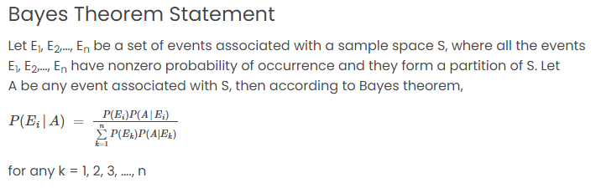

Slide 30
What is Bayes Theorem?
“ Bayes’ theorem describes the probability of occurrence of an event related to any condition. It is also considered for the case of conditional probability.”
Bayes theorem is one of the most popular machine learning concepts that helps to calculate the probability of occurring one event with uncertain knowledge while other one has already occurred.
Bayes' theorem can be derived using product rule and conditional probability of event X with known event Y:
According to the product rule we can express as the probability of event X with known event Y as follows;
P(X ? Y)= P(X|Y) P(Y) {equation 1}
Further, the probability of event Y with known event X:
P(X ? Y)= P(Y|X) P(X) {equation 2}
Mathematically, Bayes theorem can be expressed by combining both equations on right hand side. We will get:
Here, both events X and Y are independent events which means probability of outcome of both events does not depends one another.
The above equation is called as Bayes Rule or Bayes Theorem.

Slide 31
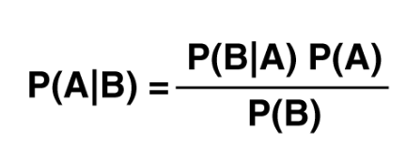
P(X|Y) is called as posterior, which we need to calculate. It is defined as updated probability after considering the evidence.
P(Y|X) is called the likelihood. It is the probability of evidence when hypothesis is true.
P(X) is called the prior probability, probability of hypothesis before considering the evidence
P(Y) is called marginal probability. It is defined as the probability of evidence under any consideration.
Hence, Bayes Theorem can be written as:
posterior = likelihood * prior / evidence

Slide 32
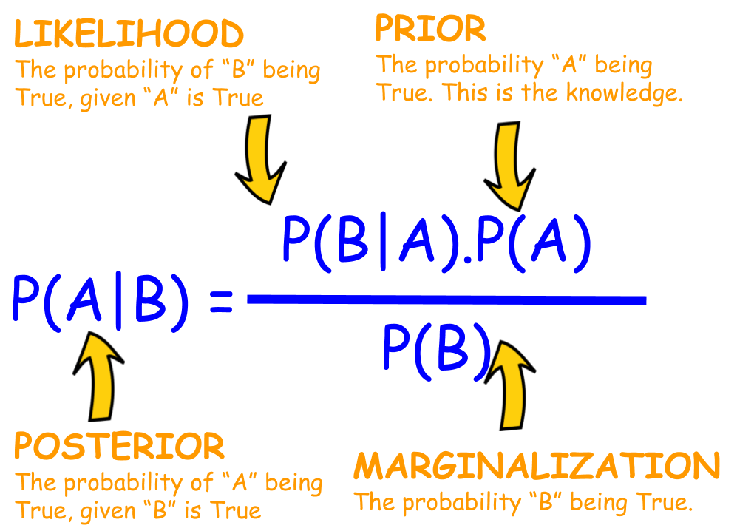

Slide 33
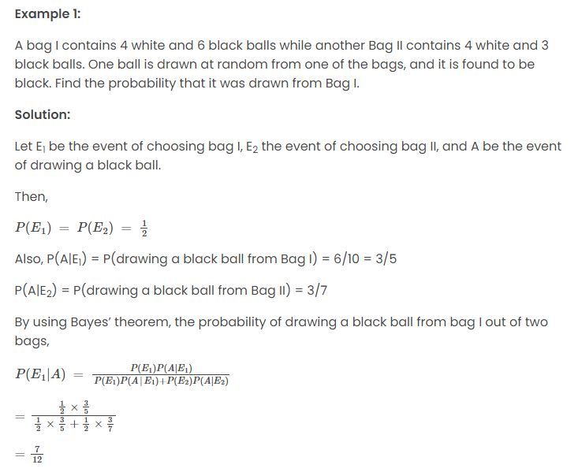

Slide 34
Bayes' Theorem Application
Applications of the theorem are widespread and not limited to the financial realm.
As an example, Bayes' theorem can be used to determine the accuracy of medical test results by taking into consideration how likely any given person is to have a disease and the general accuracy of the test.
Bayes' theorem relies on incorporating prior probability distributions in order to generate posterior probabilities.

Slide 35
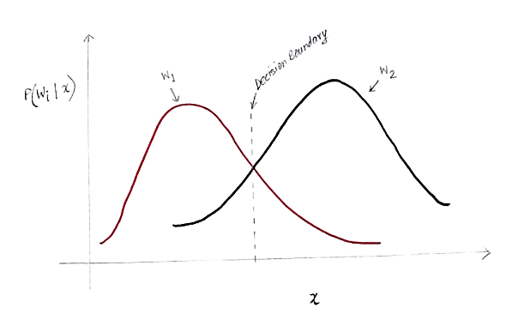
Risk Calculation
The y-axis is the posterior probability P(w(i) | x) and the x-axis is our feature ‘x’. The axis where the posterior probability for both the classes is equal, that axis is called our decision boundary.

Slide 36
Risk Calculation
So at Decision Boundary:
P(w1 | x) = P(w2 | x)
So to the left of the decision boundary, we decide in favor of w1(buying a computer) and to the right of the decision boundary, we decide in favor of w2(not buying a computer).
But, as you can see in the graph, there is some non-zero magnitude of w2 to the left of the decision boundary. Also, there is some non-zero magnitude of w1 to the right of the decision boundary. This extension of another class over another class is what you call a risk or probability error.

Slide 37

Calculation of Probability Error
To calculate the probability of error for class w1, we need to find the probability that the class is w2 in the area that is to the left of the decision boundary. Similarly, the probability of error for class w2 is the probability that the class is w1 in the area that is to the right of the decision boundary.
Mathematically speaking, the minimum error for class:
w1 is P(w2 | x)
And for class w2 is P(w1 | x)

Slide 38

Calculation of Probability Error
Let us denote the probability of total error for a feature x to be P(E | x). Total error for a feature x would be the sum of all the probabilities of error for that feature x. Using simple integration, we can solve this and the result we get is:
P(E | x) = minimum (P(w1 | x) , P(w2 | x))
Therefore, our probability of total error is the minimum of the posterior probability for both the classes. We are taking the minimum of a class because ultimately we will give a decision based on the other class.

Slide 39

Discriminant Function
Discriminant Analysis or Normal Discriminant Analysis or Discriminant Function Analysis is a dimensionality reduction technique that is commonly used for supervised classification problems.
It is used for modelling differences in groups i.e. separating two or more classes.
It is used to project the features in higher dimension space into a lower dimension space.

Slide 40
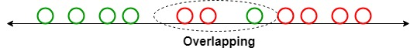
Discriminant Function
For example, we have two classes, and we need to separate them efficiently. Classes can have multiple features.
Using only a single feature to classify them may result in some overlapping as shown in the below figure.
So, we will keep on increasing the number of features for proper classification.

Slide 41
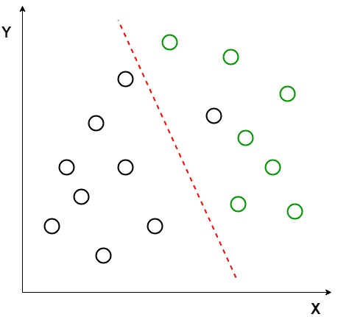
Example
Suppose we have two sets of data points belonging to two different classes that we want to classify.
As shown in the given 2D graph, when the data points are plotted on the 2D plane, there’s no straight line that can separate the two classes of the data points completely. Hence,
in this case, LDA (Linear Discriminant Analysis) is used which reduces the 2D graph into a 1D graph in order to maximize the separability between the two classes.

Slide 42
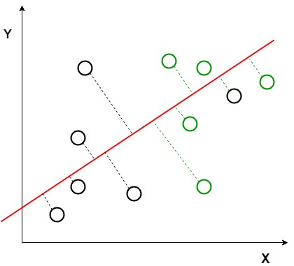
Example
Two criteria are used by LDA to create a new axis:
Maximize the distance between means of the two classes.
Minimize the variation within each class.

Slide 43
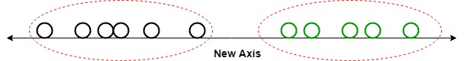
Example
In the given graph, a new axis (in red) is generated and plotted in the 2D graph such that it maximizes the distance between the means of the two classes and minimizes the variation within each class.
In simple terms, this newly generated axis increases the separation between the data points of the two classes. After generating this new axis using the above-mentioned criteria, all the data points of the classes are plotted on this new axis and are shown in the figure given below.

Slide 44
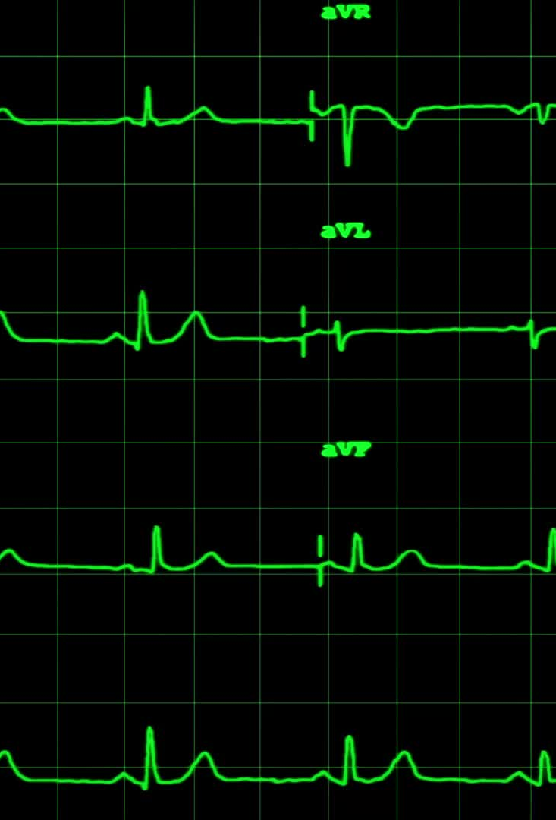
Utility Functions
The agents use the utility theory for making decisions. It is the mapping from lotteries to the real numbers.
An agent is supposed to have various preferences and can choose the one which best fits his necessity.

Slide 45

Utility Functions
To help an agent in making decisions and behave accordingly, we need to build a decision-theoretic system. For this, we need to understand the utility function. This process is known as preference induction. In this, the agents are provided with some choices and using the observed preferences, the respected utility function is chosen. Generally, there is no scale for the utility function. But a scale can be established by fixing the boiling and freezing point of water.
Thus, the utility is fixed as:
U(S)=uT for best possible cases
U(S)= u? for worst possible cases.

Slide 46
Utility Functions
A normalized utility function uses a utility scale with value uT=1, and u? =0. For example, a utility scale between uT and u? is given.
Thereby an agent can choose a utility value between any prize Z and the standard lottery [p, u_; (1?p), u?]. Here, p denotes the probability which is adjusted until the agent is adequate between Z and the standard lottery.
Like in medical, transportation, and environmental decision problems, we use two measurement units: micromort or QUALY(quality-adjusted life year) to measure the chances of death of a person.

Slide 47

Bias and Variance
Bias and variance are used in supervised machine learning, in which an algorithm learns from training data or a sample data set of known quantities. The correct balance of bias and variance is vital to building machine-learning algorithms that create accurate results from their models.

Slide 48
Bias and Variance
Machine learning algorithms use mathematical or statistical models with inherent errors in two categories: reducible and irreducible error.
Irreducible error, or inherent uncertainty, is due to natural variability within a system. In comparison, reducible error is more controllable and should be minimized to ensure higher accuracy.
Bias and variance are components of reducible error. Reducing errors requires selecting models that have appropriate complexity and flexibility, as well as suitable training data. Data scientists must thoroughly understand the difference between bias and variance to reduce error and build accurate models.

Slide 49
Bias
Also called “error due to squared bias,” bias is the amount that a model’s prediction differs from the target value, compared to the training data. Bias error results from simplifying the assumptions used in a model so the target functions are easier to approximate. Bias can be introduced by model selection. Data scientists conduct resampling to repeat the model building process and derive the average of prediction values. Resampling data is the process of extracting new samples from a data set in order to get more accurate results. There are a variety of ways to resample data including:
K fold resampling, in which a given data set is split into a K number of sections, or folds, where each fold is used as a testing set.
Bootstrapping, which involves iteratively resampling a dataset with replacement.
Resampling can affect bias. If the average prediction values are significantly different from the true value based on the sample data, the model has a high level of bias.

Slide 50
Variance
Variance indicates how much the estimate of the target function will alter if different training data were used. In other words, variance describes how much a random variable differs from its expected value. Variance is based on a single training set. Variance measures the inconsistency of different predictions using different training sets — it’s not a measure of overall accuracy.
Variance can lead to overfitting, in which small fluctuations in the training set are magnified. A model with high-level variance may reflect random noise in the training data set instead of the target function. The model should be able to identify the underlying connections between the input data and variables of the output.

Slide 51
Variance
A model with low variance means sampled data is close to where the model predicted it would be. A model with high variance will result in significant changes to the projections of the target function.
Machine learning algorithms with low variance include linear regression, logistics regression, and linear discriminant analysis. Those with high variance include decision trees, support vector machines and k-nearest neighbors.

Slide 52
Parametric Methods
The basic idea behind the parametric method is that there is a set of fixed parameters that uses to determine a probability model that is used in Machine Learning as well.
Parametric methods are those methods for which we priory knows that the population is normal, or if not then we can easily approximate it using a normal distribution which is possible by invoking the Central Limit Theorem.
Parameters for using the normal distribution is –
Mean
Standard Deviation

Slide 53
Parametric Methods
Eventually, the classification of a method to be parametric is completely depends on the presumptions that are made about a population. There are many parametric methods available some of them are:
Confidence interval used for – population mean along with known standard deviation.
The confidence interval is used for – population means along with the unknown standard deviation.
The confidence interval for population variance.
The confidence interval for the difference of two means, with unknown standard deviation.

Slide 54
Thank You !!

